Slide 1
Interpersonal Communication
Asad Nassir, Assia Malek, Caroline Zeller, Roxana Lazar

Slide 2
Organisation in the company:
Management
Marketing Manager
Production Manager
Administration Manager
Estimating and Costing
Customer Service
Marketing
Sales
Research & Development
Material Logistics
Manufactering
Quality Management
Purchasing
Pre-press
Printing
Finishing
Warehouse & Packaging
Despatch
Four directions:
Downwards
Upwards
Horizontally
Diagonally

Slide 3




Communication in Organisations:
Two ways:
Formal: email, report, message, bulletin
Informal: social life with colleagues, gossip
Managers have to improve their skills through:
Trainings
Coaching's

Slide 4
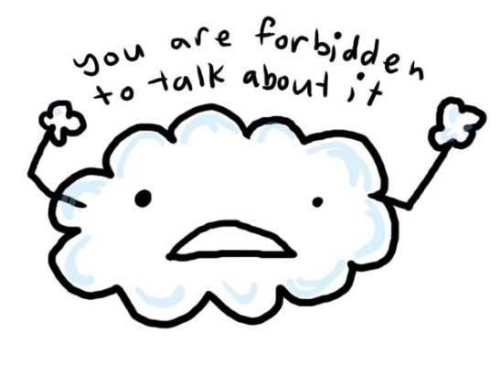

Identified problems:
1. Different departments are working independent:
Reasons:
No cooperation between the divisions
No diagonal communication
No horizontal communication
Every department concentrate on their own target
Managers don’t communicate with each other
Solutions:
Organise more meetings
Trainings for managers

Slide 5


Identified problems:
2. Some of the staff think they are specialist tradesmen:
Reasons:
Company isn’t well organised
Individual concentrate only on their own goals
Different perception
Some manager shouldn’t work in this position
Solutions:
Explain everybody his functions
Organize more meetings
Encourage teamwork

Slide 6






Identified problems: It is part of the current policy to communicate using email
Fast transmision
Any distance

Slide 7


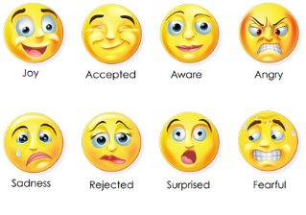
E-mail : 1. Little information
conflicts
misunderstanding
2. Wrong emotions
3. Stress
4. Lack of relationship=Lack of trust

Slide 8


Relationships Time
E-mail Face-to-face

Slide 9




Identified problems There is an air of suspicion and mistrust between the management and staff
Trust affects: -communication
-cooperation
-information sharing
-productivity

Slide 10




Communication
Accurate information
Explanations for Decisions
Sincere and Appropriate Openness
Cooperation
Mission/vision/strategy

Slide 11
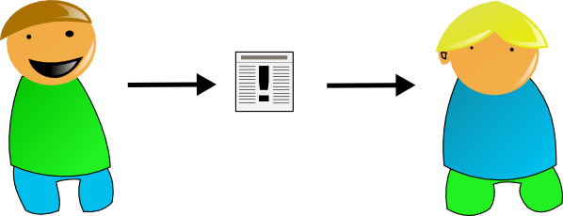
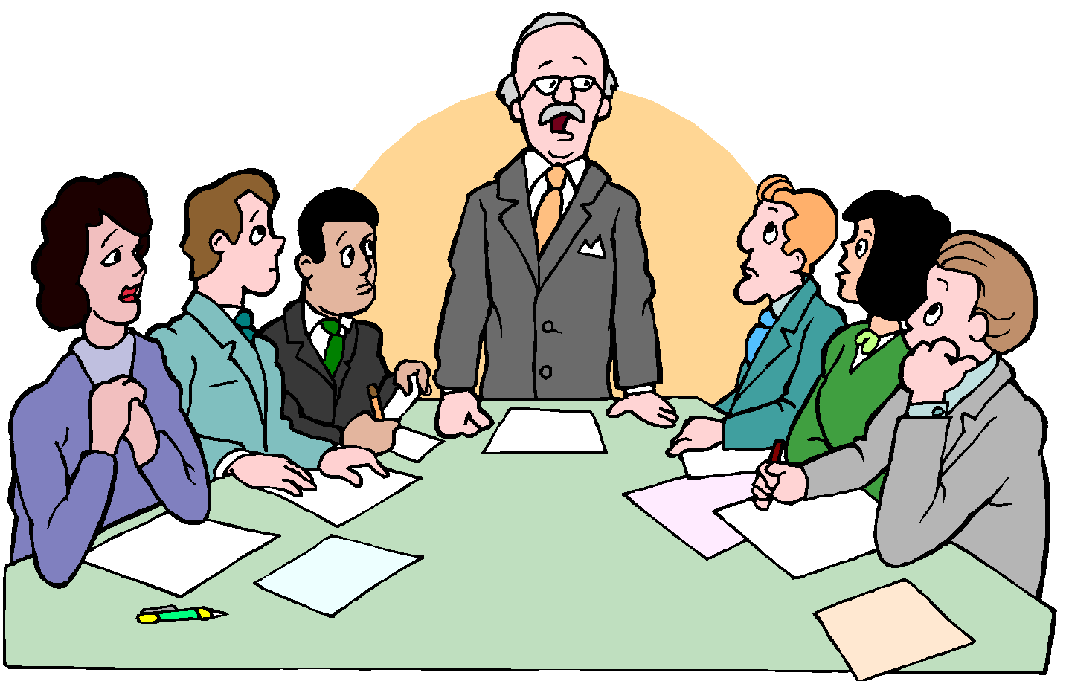


Communication messages
Information
Directness and Commitment
Efficiency
Productivity
High level of Commitment

Slide 12

Lack of trust affects the whole organization, because trust is a basic element of functioning relationships in organization.

Slide 13
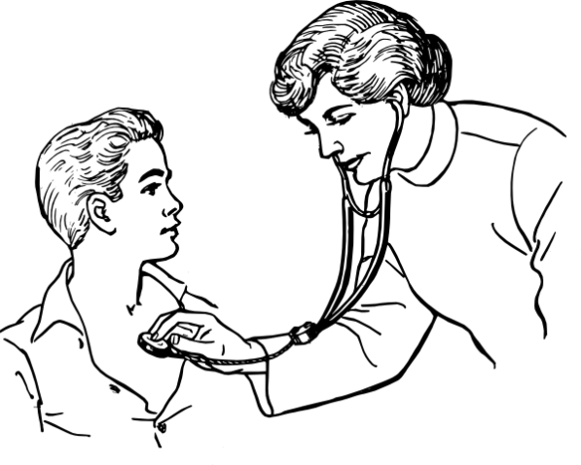


Identified problems
The amount of sick-leave and bad time-keeping is unacceptable
Sick-leave reasons:
Health Problems 2. Crisis in Personal Life
3. Harassment at Work

Slide 14

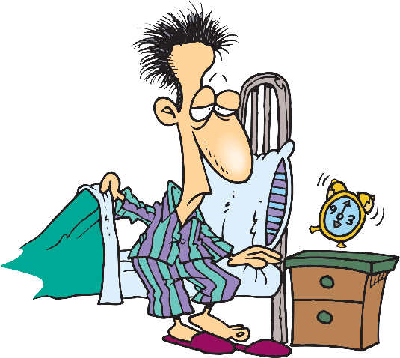

Non-attendance affects the rest of the staff
The manager should lay down some clear ground rules on timekeeping

Slide 15



Identified Problems Re-runs on job orders are common because of errors in communication regarding the job order and customer’s requirements
Employees communicate with customers:
Over the phone
Via email
Face-to-face

Slide 16



Effective Customer Communication
Listen carefully
Understand
Communicate effectively

Slide 17











Any Questions?

